Slide 1
Dynamic Testing Results
Greg + Mike

Slide 2
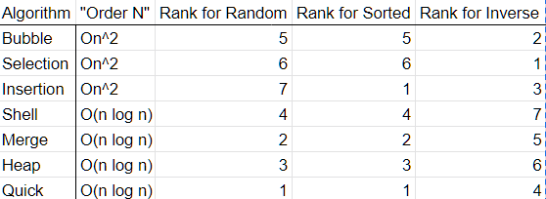
Pre-Ranking

Slide 3
Notes on Testing
All test times should be read in milliseconds
Tests performed with default 1000000 items to sort
Tests done by Greg performed on Gradescope servers
Tests done by Mike performed on local computer
Tests performed in three configurations
Random -- Arrays populated by letters arranged in random patterned
Sorted -- Arrays have been sorted in natural order prior to test.
Inverse -- Arrays have been sorted in inverse natural order prior to test

Slide 4
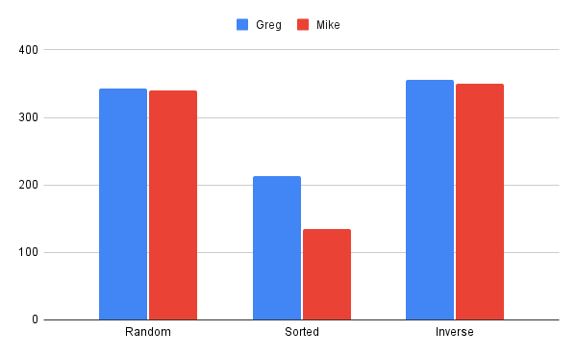
Bubble Sort

Slide 5
Bubble Sort Observation
Random and Inverse appear to have roughly similar sorting times
Sorted was the quickest for Bubble Sort to process

Slide 6
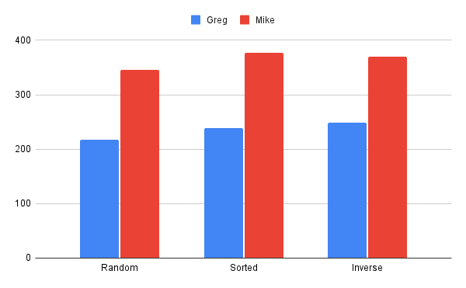
Heap Sort

Slide 7
Heap Sort Observation
All sort types had roughly the same timing
Given the method of sorting from a heap, this is expected, as “heapify” method undoes all previous sorting

Slide 8
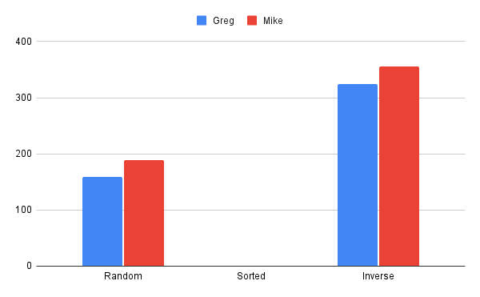
Insertion Sort

Slide 9
Insertion Sort Observation
Sorted scenario took no time, as the code recognized it was complete and terminated.
Random took the least amount of time other then sorted
Inverse took the most time

Slide 10
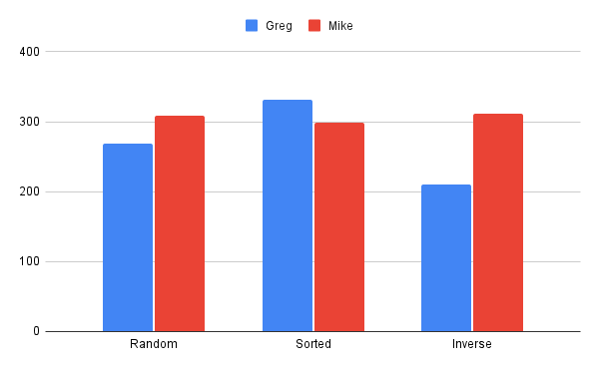
Merge Sort

Slide 11
Merge Sort Observation
All scenarios were fairly similar in timing--exception of Greg’s inverse sort
Given divide and conquer being performed this would be expected

Slide 12
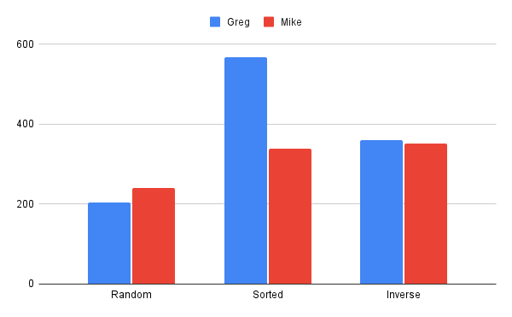
Quick Sort

Slide 13
Quick Sort Observation
Random scenario was universally the fastest, with sorted and inverse being remarkably similar
Greg’s sorted results outlier. Possible mistake in code that would require further exploration

Slide 14
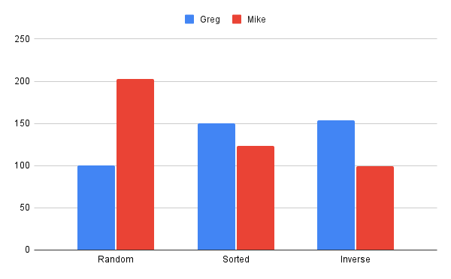
Selection Sort

Slide 15
Selection Sort Observation
Unexpected variance here
Greg’s Inverse and Sorted scenarios are similar, Random is significantly faster
Mike’s Inverse and Sorted scenario are similar, Random is significantly slower
Possible inefficiency in Mike’s code

Slide 16
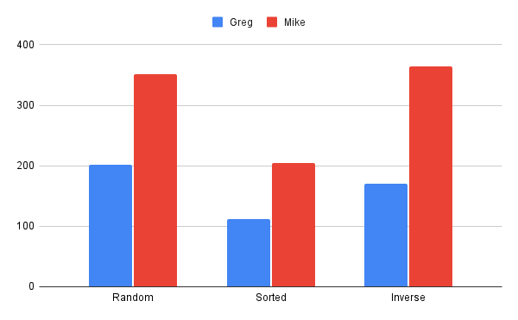
Shell Sort

Slide 17
Shell Sort Observation
Sorted universally fastest, with Random and Inverse similar
Shell sort acts as variant of Insertion sort, so Sorted is fastest for both

Slide 18
Data Summary
Selection Sort most efficient overall
Average time of 138.16ms across all tests
Inverse
Selection Sort fastest
99ms Mike/154ms Greg
Sorted
Insertion Sort fastest at 0ms
Shell and Selection Sort close behind
Selection Sort 123ms Mike
Shell Sort 112ms Greg
Random
Selection Sort and Insertion Sort
Insertion Sort 159ms Mike
Selection Sort 100ms Greg

Slide 19
Conclusion
Static Analysis estimation was off
Predicted Quick Sort as overall fastest
Was actually 343.83ms average
Amongst the worst
Did not rate Selection Sort highly
As stated, was the most efficient
Impact of Gradescope unknown
No handle on background processes
Hard to control additional variables
Would ideally want a “test computer” to introduce control

